Slide 1
Emerging Trends Presentation
KATELYN nEUHAUS

Slide 2

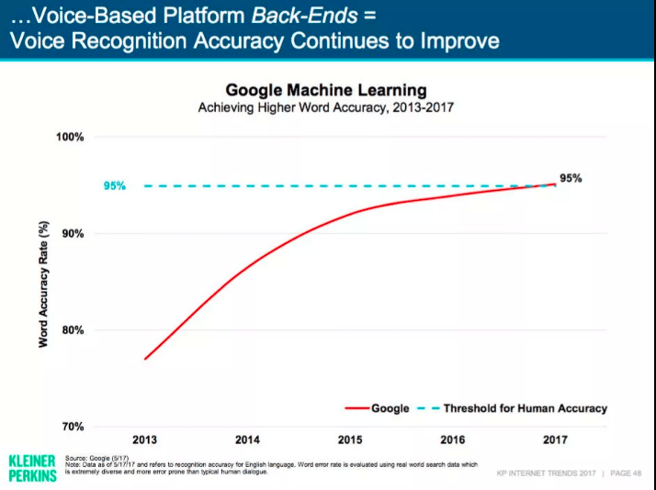
Voice search optimization
Consumers are becoming more comfortable using voice search optimization software such as Siri and Alexa. Nearly 420 million voice assistants have been sold to date.
The technology around voice search has become more accurate. The accuracy rate has improved to around 93% in the past five to six years.
According to Google 20% of mobile searches are voice searches and it is estimated that by 2020 50% of searches will be done via voice.
Voice optimization can be easily incorporated into websites and is supported by browsers such as Google Chrome and Firefox.
The voice search optimization technology is convenient for everyone and I can see how it could be a great tool for those with disabilities.

Slide 3
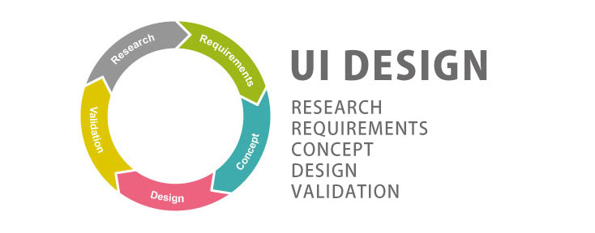
User interface design
Accelerated mobile pages (AMP) allow webpages to load instantaneously and work seamlessly on mobile devices.
AMP also supports code that works on multiple platforms and devices and allows websites to utilize video, animation and graphics.
Progressive web apps (PWA) works online or with a poor internet connection and provides a high-end browsing experience.
E-commerce apps are a common use for the (PWA) technology.
This technology has the potential to improve the user experience by making is available to those who don't always have a good internet connection.

Slide 4
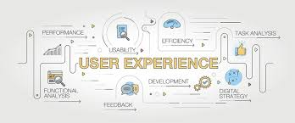
User Experience
Chatbots are increasingly being used for customer service. In fact, 48% of consumers prefer to contact a company via live chat.
Chatbots have the potential to save companies billions of dollars in customer service costs.
Motion UI is one of the main design trends of the coming year. This technology is being used to capture and hold the user's attention.
Motion UI includes designs elements such as page header transitions, animated charts, background animations and modular scrolling.
I recently purchased a new computer and use the chatbot technology during that purchase and I found very convenient and helpful. As a consumer I enjoyed this technology and can see how it would be an advantage for companies.

